Slide 1
Natural Language Processing (NLP)
WAES1102

Slide 2
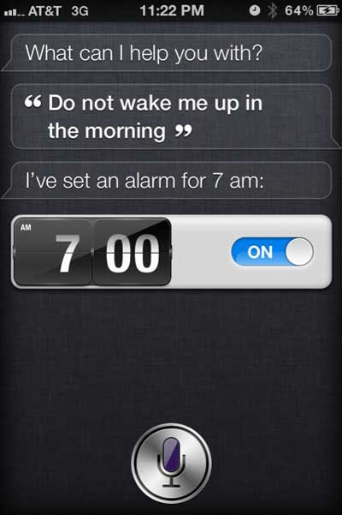
Scene 1

Slide 3
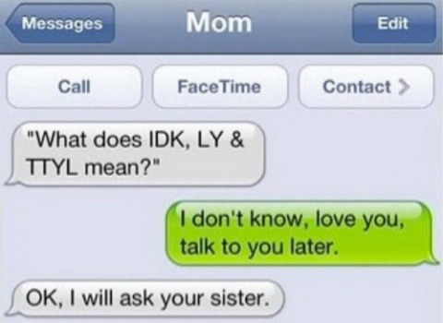
Scene 2

Slide 4
Scene 3
John saw the man on the mountain with a telescope.
Who has the telescope? John, the man on the mountain, or the mountain?

Slide 5
What is Natural Language Processing?
Natural Language Processing
  Process information contained in natural language text.
  Also known as Computational Linguistics (CL), Human Language Technology (HLT), Natural Language Engineering (NLE)
Can machines understand human language?
  Define ‘understand’
  Understanding is the ultimate goal. However, one doesn’t need to fully understand to be useful.

Slide 6
What is it..
Analyze, understand and generate human languages just like humans do.
Applying computational techniques to language domain..
To explain linguistic theories, to use the theories to build systems that can be of social use..
Started off as a branch of Artificial Intelligence..
Borrows from Linguistics, Psycholinguistics, Cognitive Science & Statistics.
Make computers learn our language rather than we learn theirs.

Slide 7
Why Study NLP?
A hallmark of human intelligence.
Text is the largest repository of human knowledge and is growing quickly.
  emails, news articles, web pages, IM, scientific articles, insurance claims, customer complaint letters, transcripts of phone calls, technical documents, government documents, patent portfolios, court decisions, contracts, ……
  Are we reading any faster than before?

Slide 8
Why are language technologies needed?
Many companies would make a lot of money if they could use computer programmes that understood text or speech. Just imagine if a computer could be used for:
  answering the phone, and replying to a question
  understanding the text on a Web page to decide who it might be of interest to
  translating a daily newspaper from Japanese to English (an attempt is made to do this already)
  understanding text in journals / books and building an expert systems based on that understanding

Slide 9
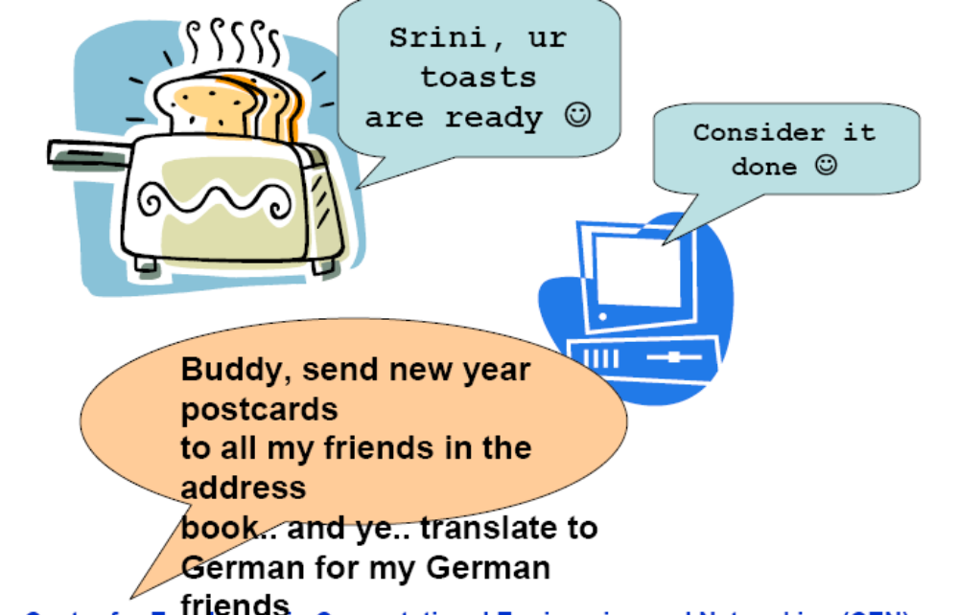
Dreams??

Slide 10
Where does it fit in the CS taxonomy?
Computers
Databases
Artificial Intelligence
Algorithms
Networking
Robotics
Natural Language Processing
Search
Information
Retrieval
Machine
Translation
Language
Analysis
Semantics
Parsing

Slide 11
Early days..
How to measure Intelligence of a Machine?
Turing test – Alan Turing (1950)
  A machine can be accepted to be intelligent if it can fool a judge that its human over a tele-typing exercise.
ELIZA by Weizenbaum (1966)
  Pretends to be a psychiatrist and converses with a user on his problems.
  Uses Keyword pattern matching
  Many users thought the machine really understood their problem.
  Many such systems exist now. E.g. Alan, Alice, David
  Can such tests be taken as a measure for Intelligence ? Debate goes on..

Slide 12
Linguistic data is ubiquitous
Most of the information in most companies, organizations, etc. material in human languages (reports, customer email, web pages, discussion papers, text, sound, video) – not stuff in traditional databases
  Estimates: 70%, 90% ?? [all depends how you measure]. Most of it.
Most of that information is now available in digital form:
  Estimate for companies in 1998: about 60% [CAP Ventures/Fuji Xerox]. More like 90% now?

Slide 13
The problem
When people see text, they understand its meaning (by and large)
When computers see text, they get only character strings (and perhaps HTML tags)
We'd like computer agents to see meanings and be able to intelligently process text
These desires have led to many proposals for structured, semantically marked up formats
But often human beings still resolutely make use of text in human languages.

Slide 14
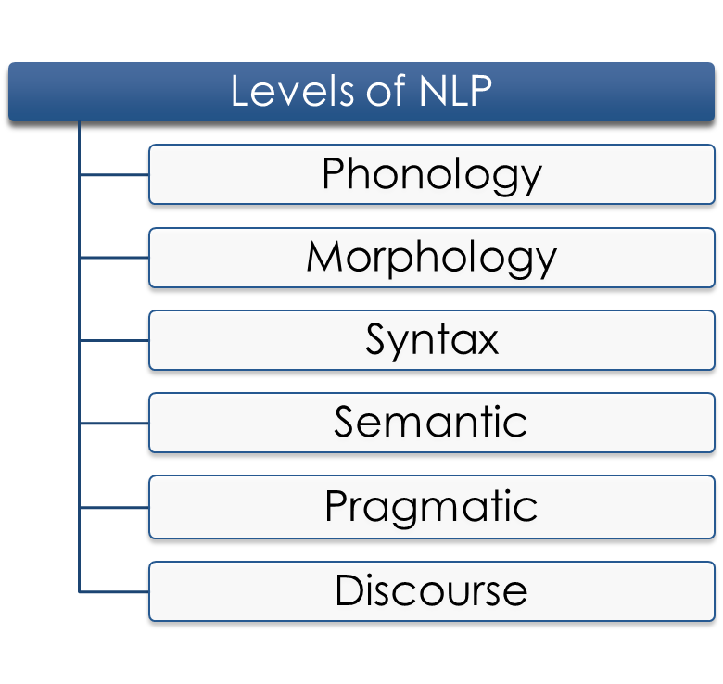
Levels of NLP
Pronunciation of words
Formation of words
Structure of sentences
Meaning of sentences
Interpretation of
sentences
Interpretation of
the whole text

Slide 15
Phonology
Speech processing
  Humans process speech remarkably well.
  Speech interface can replace keyboards and monitors.
  Convert Acoustic signals to Text.
  Phonemes are the smallest recognizable speech unit in a language.
  Graphemes are the textual representation.
  Phonemes can be identified using their phonetic & spectral features.

Slide 16
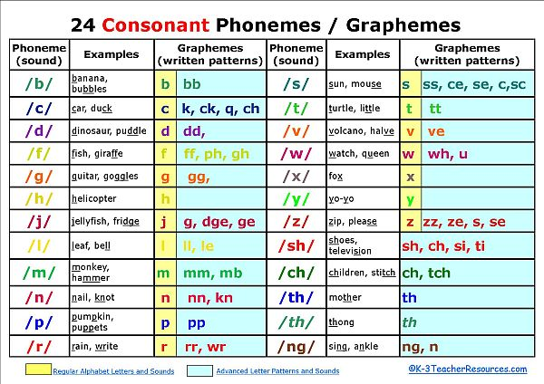
English Phonemes/Graphemes

Slide 17
Speech – So is it difficult ?
“It's very hard to wreck a nice beach ”
Pronunciation of different speakers
Pace of speech
Speech ambiguity – Homonyms
  I ate eight cakes
  That band is banned
  I went to the mall near by to buy some food
  The Finnish were the first ones to finish
  I know no James Bond.

Slide 18
Morphology: What is a word?
Morphology is all about the words.
Make more words from less ☺.
Structures and patterns in words
Analyzes how words are formed from minimal units of meaning, or morphemes, e.g., dogs= dog+s.
Words are a sequence of Morphemes.
  Morpheme – smallest meaningful unit in a word. Free & Bound.
Inflectional Morphology – Same Part of Speech
  Buses = Bus + es
  Carried = Carry + ed
Derivational Morphology – Change PoS.
  Destruct + ion = Destruction (Noun)
  Beauty + ful = Beautiful (Adjective)
Affixes – Prefixes, Suffixes & Infixes
Rules govern the fusion.

Slide 19
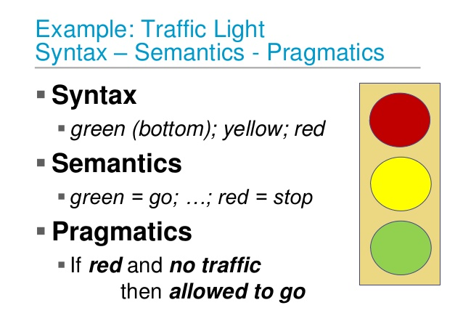
Syntax vs Semantics vs Pragmatics

Slide 20
Syntax
Words convey meaning. But when they are put together they convey more.
Syntax is the grammatical structure of the sentence. Just like the syntax in programming languages.
  structures and patterns in phrases
  how phrases are formed by smaller phrases and words
Identifying the structure is the first step towards understanding the meaning of the sentence.
Syntactic Analysis (Parsing) = Process of assigning a parse tree to a sentence.

Slide 21
Is that all?
Grammar of a language is very complex.
No one can write down the set of all rules that governs the sentence construction.
Naturally the solution is Machine Learning.
Where do they learn from? – Tree banks.
E.g. Penn Treebank – Manually annotated trees for sentences (over 2 mil words) from a large Wall Street Journal corpus.

Slide 22
Semantics
What do you mean..?
Words – Lexical Semantics
Sentences – Compositional Semantics
Converting the syntactic structures to semantic format – meaning representation.
Semantics: the meaning of a word or phrase within a sentence.

Slide 23
Pragmatics
Pragmatics: structures and patterns in discourses.
Sentence standing alone may not mean so much. It may be ambiguous.
What information is contained in the contextual sentences that is not conveyed in the actual sentence?
Discourse / Context makes utterances more complicated.
  Implicatures:
    How many times do you go skating each week?
  Speech acts:
    Do you know the time?
  Anaphora – Resolving the pronoun’s reference. Co-reference resolution
    “I read the book by Dr. Kalam. It was great”
    “We gave the monkeys the bananas because they were hungry”
    Jane races Mary on weekends. She often beats her.

Slide 24
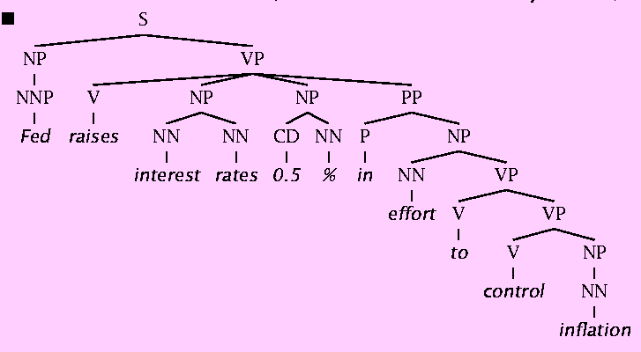
Why is Natural Language Understanding difficult?
The hidden structure of language is highly ambiguous
Structures for: Fed raises interest rates 0.5% in effort to control inflation (NYT headline 5/17/00)

Slide 25
Challenges in NLP: Ambiguity
Words or phrases can often be understood in multiple ways.
  Teacher Strikes Idle Kids
  Killer Sentenced to Die for Second Time in 10 Years
  They denied the petition for his release that was signed by over 10,000 people.
  child abuse expert/child computer expert

Slide 26
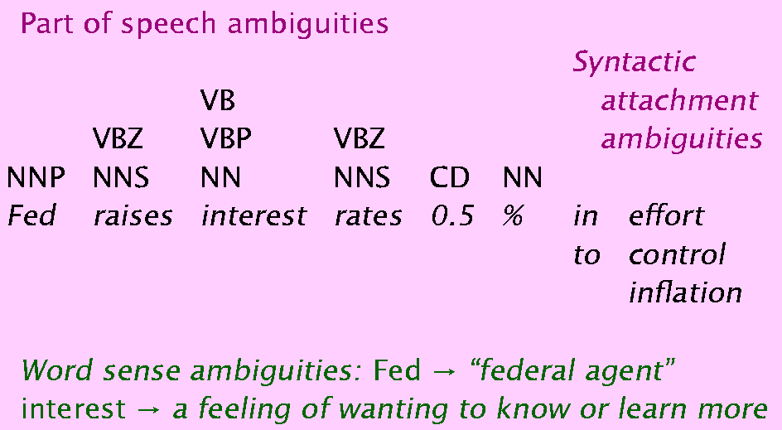
Where are the ambiguities?

Slide 27
Probabilistic/Statistical Resolution of Ambiguities
When there are ambiguities, choose the interpretation with the highest probability.
Example: how many times peoples say
  “Mary loves …”
  “the Mary love”
Which interpretation has the highest probability?

Slide 28
Parsing
Analyze the structure of a sentence
S
NP
VP
PP
NP
NP
D
N
V
D
N
P
D
N
The student put the book on the table

Slide 29
S
S
VP
VP
NP
NP
NP
NP
N
N
V
N
N
V
A
N
Teacher strikes idle kids
Teacher strikes idle kids

Slide 30
Enabling Technologies
Stemming
  Reduce detects, detected, detecting, detect, to the same form.
POS Tagging
  Determine for each word whether it is a noun, adjective, verb, …..
Parsing
  sentence ⇒ parse tree
Word Sense Disambiguation
  orange juice vs. orange coat
Learning from text

Slide 31
NLP Applications
Question answering
  Who is the first Taiwanese president?
Text Categorization/Routing
  e.g., customer e-mails.
Text Mining
  e.g., find everything that interacts with X subject.
Machine (Assisted) Translation
Spelling correction
  Is that just dictionary lookup?

Slide 32
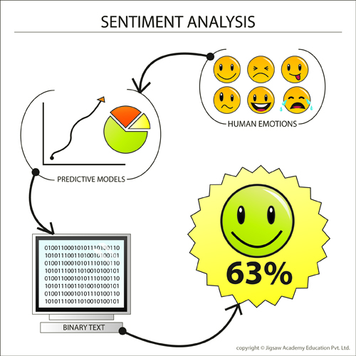
Sentiment Analysis
Sentiment is the attitude, opinion or feeling toward something, such as a person, organization, product or location.
Sentiment analysis provides easy-to-use mechanisms to identify the positive or negative sentiment within any document or webpage.
Demo: Sentiment140

Slide 33
Application areas
Text-to-Speech & Speech recognition
Information Retrieval
Information Extraction
Document Classification
Document Image Analysis
Automatic Summarization
Text Proofreading – Spelling & Grammar
Story understanding systems
Plagiarism detection
Can u think of anything else ??

Slide 34
Conclusion
Complete human-level natural language understanding is still a distant goal
But there are now practical and usable partial NLU systems applicable to many problems
An important design decision is in finding an appropriate match between (parts of) the application domain and the available methods
But, used with care, statistical NLP methods have opened up new possibilities for high performance text understanding systems.

